Slide 1

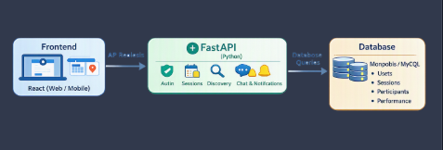
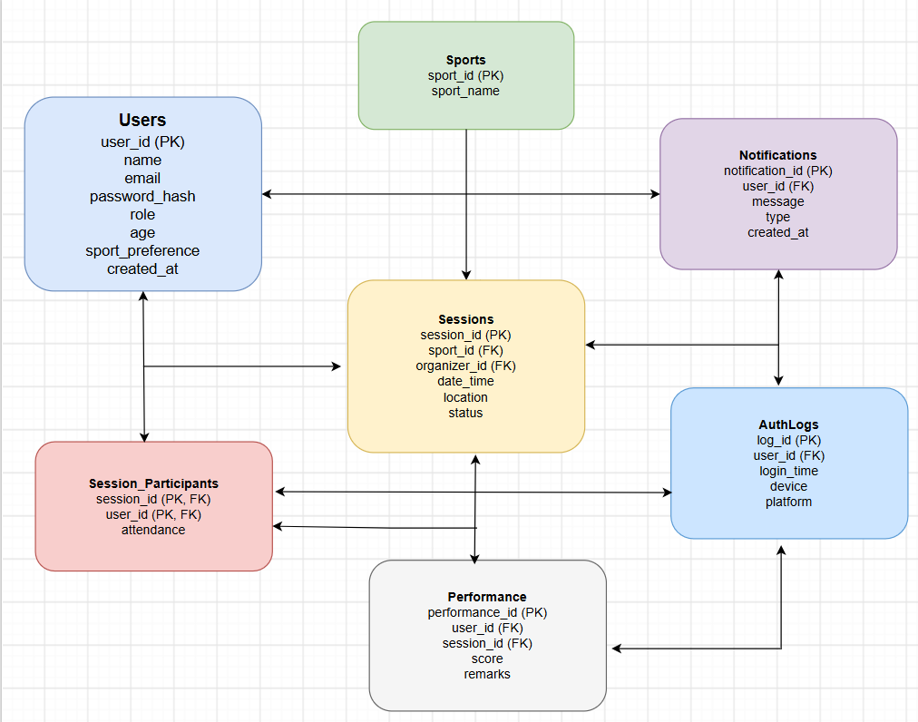
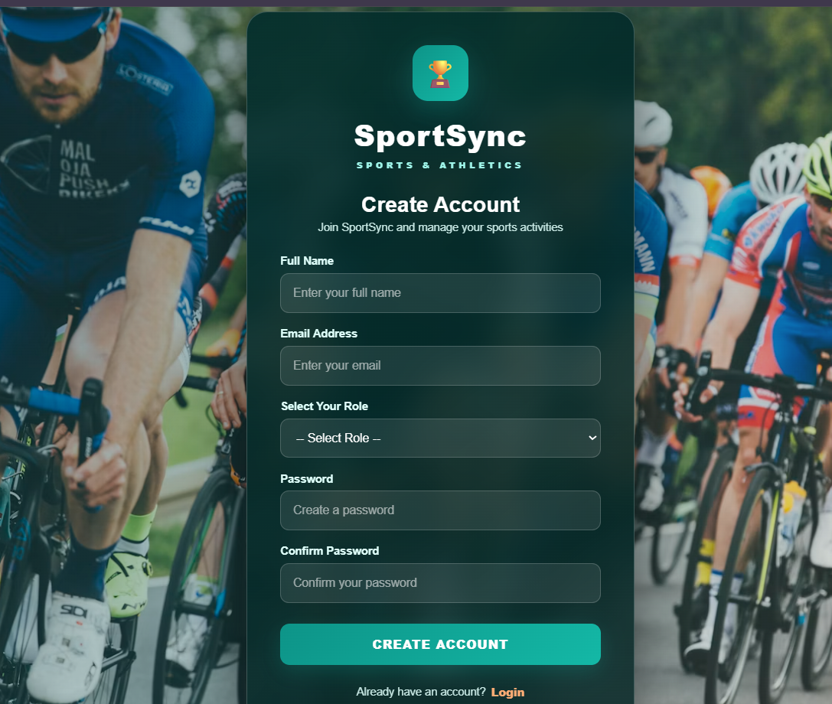
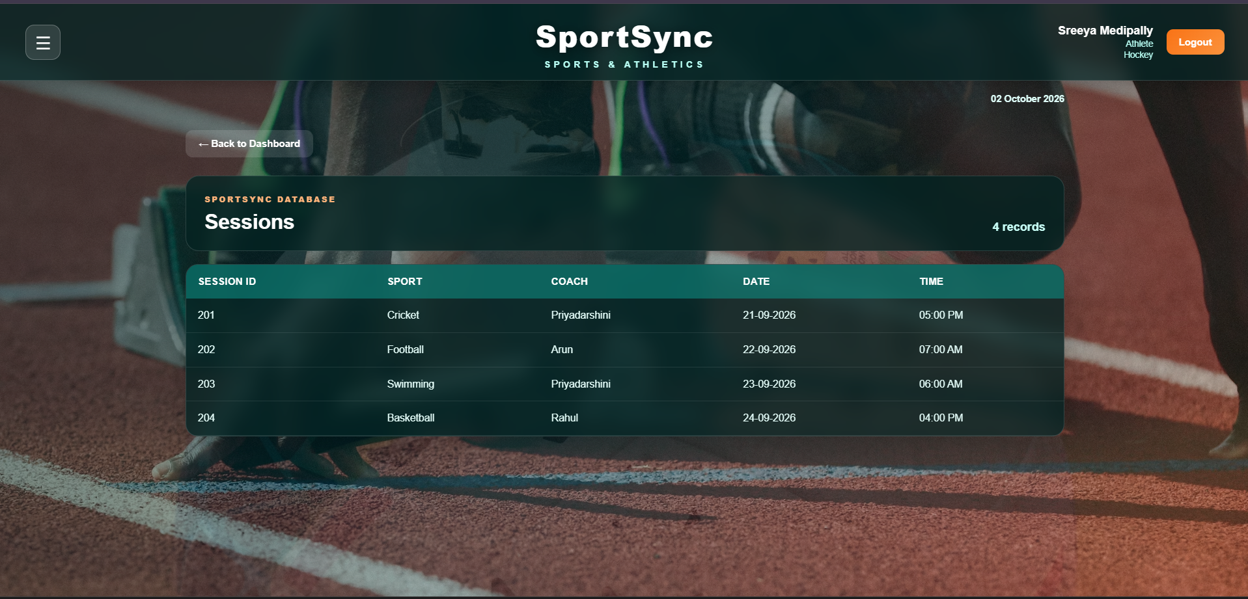
KLH Logo
CROSS-PLATFORM MATCH/SESSION APP FOR SPORTS & ATHLETICS
Team ID: 05 | Section: 09
Members: [Priya Dharshini – 2520030067], [Sreeya – 2500032243], [Aashrita – 2520030178] Guide: Prasanthi
Database Systems Engineering and Distributed Backend Development (25CS1302E) | KLH Bachupally Campus, CSE|PBL 2026-27
Abstract
Tools & Technologies
A cross‑platform web application built with React (frontend), Node.js + Express (backend), and MySQL (database). The system enables secure login, session management, and real‑time participant tracking
Outcome: Streamlined scheduling and participation tracking for sports activities.
Front-End: React(cross‑platform web UI)
Back-End: Node.js + Fast API
Database: MySQL(portable server runtime)
Tools: [Git & GitHub, Postman, VS Code, Draw.io]
Problem Statement & Objectives
Problem: Existing systems lack an integrated platform for sports session scheduling, Management and participant tracking.
Objective 1: Provide secure login and registration flow.
Objective 2: Enable session creation and joining.
Objective 3: Display participant counts and notifications in real time.
Scope:Students, coaches, and organizers; modules include Login, Registration, Dashboard, Profile, Notifications, Sessions.
System Architecture
Existing vs Proposed System
Feature | Existing System | Proposed System
User Auth & Roles | Manual login; no roles | Secure login with roles (player, coach, organizer, admin)
Session Management | Manual tracking | Web dashboard for scheduling & updates
Notifications | No alerts | Real‑time reminders & updates
Performance Tracking | No records | Coaches log scores & remarks
Limitation | Isolated, no live data | Cross‑platform system for sports session management & tracking
ER Diagram & Database Design
[Insert ER diagram with entities, keys and relationships]
Feasibility Study
Technical: Skills in React, Node.js, MySQL; tools available (VS Code, GitHub).
Economic:Open‑source stack, free hosting tiers.
Operational: Easy UI, professional design, low maintenance.
Schedule: Completed within semester timeline.
Implementation Screenshots
[Screenshot 1]
[Screenshot 2]
Results & Testing
Conclusion
Future Scope
Verified CRUD operations for all modules
Successful login, session join, and notifications
Performance stable across devices
Built a working cross‑platform sports session manager
Achieved secure login, scheduling, and real‑time tracking
Add mobile app integration
Enable push notifications and analytics dashboard
References: React Docs , Node.js Docs GitHub Link: https://github.com/priyadarshini-19/DBSE-DBD_Project.git

